Slide 1
Early Communication Screening Tool – What next?
To be used alongside the Early Communication Screen Record Book and Picture Book.
November 2024

Slide 2
24 – 29 months of age | Does the child ..? |  | Suggested storybook / rhyme | Letters and Sounds : Phase 1 | Development Matters guidance
 | Point to these body parts | eyes, feet, tummy, mouth | If your clothes are very red Books and Rhymes 2 Year Olds – Sheringham Nursery (sheringham-nur.org.uk) | Story sounds (p.17) | Around their second birthday, can the toddler jump with both feet off the ground at the same time?
 | Understand commands containing 2 key words | Following-Instructions-2-Key-Words.pdf
 | Understand concepts | big and little | Dear Zoo (Rod Cambell) | Enlivening story (p.12) e.g. 3 Billy Goats Gruff | Use the language of size in everyday contexts e.g. little and big bears, shoes, cups, bowls etc.
 | Understand these verbs | jump | 5 little monkeys jumping on the bed Five little monkeys jumping on the bed - BBC Teach | Listen to the music (p.20) | Encourage toddlers to jump with both feet off the ground at the same time.
 |  | sleep | Sleeping bunnies Sleeping Bunnies song lyrics - BBC Tiny Happy People | Noisy neighbour 1 (p.21) | Join in with pretend play, modelling ‘putting baby to sleep’.
 |  | drink | Polly put the kettle on Polly put the kettle on - BBC Teach |  | Start pouring their own drinks.
 |  | eat | Little Jack Horner https://www.nurseryrhymes.org/nursery-rhymes.html |  | Start eating independently.
 |  | clap | If you are happy and you know it Nursery Rhymes and Songs - A to Z - BBC Teach | Action songs (p.20) | Join in with children’s movement play when invited and if appropriate, clapping to the music.

Slide 3
30 - 35 months of age | Does the child ..? |  | Suggested storybook / rhyme | Letters and Sounds : Phase 1 | Development Matters guidance
 | Understand commands containing 2 key words | Following-Instructions-2-Key-Words.pdf
 | Understand question words | who | My first Gruffalo: Who lives here? (Julia Donaldson & Axel Schffler) | Bertha goes to the zoo (p.32) | When talking with young children give them plenty of processing time (at least 10 seconds). This gives them time to understand what you have said and think of their reply. They will be learning to understand simple questions like ‘who’, ‘what’ and ‘where’ (but generally not ‘why’).
 |  | where | Where’s Spot? (Eric Hill) Have you seen Elephant? (David Barrow) | Socks and shakers (p.11)
 | Use words ending -ing | running painting | Baby Bear, Baby Bear, what do you see? (Bill Martin Jr / Eric Carle) | Hidden instruments (p.17) (running / skipping etc. to find the instruments). | Create an obstacle course encouraging the children to practice crawling, running, jumping. Create a large outdoor painting area with large brushes, rollers etc.
 | Use plural – s ending | apples flowers | The very hungry caterpillar (Eric Carle) The wheels on the bus The Wheels on the Bus: Nursery Rhymes for Babies - BBC Tiny Happy People | Action songs (p.20) | Model accurate use of plurals. “Look there are two apples”. Helping toddlers to say words properly by recasting How to help when toddlers say words wrong - BBC Tiny Happy People

Slide 4
36 – 41 months of age | Does the child ...? |  | Suggested storybook / rhyme | Letters and Sounds : Phase 1 | Development Matters guidance
 | Understand commands containing 3 key words | Following-Instructions-3-Key-Words.pdf |  |  | Observational checkpoint: can the child follow instructions with 3 key words like: ‘Can you wash dolly’s face?’
 | Understand positional words | in | Rub-a-dub, dub Rub-a-dub dub - BBC Teach | Enlivening story (p.12) e.g. Peace at Last (Jill Murphy) | Use spatial words in play, including ‘in’, ‘on’, ‘under’… Suggestion: “Let’s put the troll under the bridge and billy goat on the bridge.” Describe children’s climbing, tunnelling and hiding using these positional words.
 |  | under | Little Boy Blue Little Boy Blue come blow your horn - BBC Teach
 |  |  | Rosie’s Walk (Pat Hutchins)
 |  | on | The wheels on the bus The Wheels on the Bus: Nursery Rhymes for Babies - BBC Tiny Happy People
 | Understand question words | Who | Who sank the boat? (Pauline Allen) | Bertha goes to the zoo (p.32) | When talking with young children, give them plenty of processing time (at least 10 seconds). This gives them time to understand what you have said and think of their reply.
 |  | Where | Where’s my teddy? (Jez Alborough) | Socks and shakers (p.11)
 | Use plural – s ending | apples flowers | Handa’s Surprise (Eileen Brown) |  | Model accurate use of plurals. “Look there are two apples”.

Slide 5
42 – 47 months of age | Does the child ..? |  | Suggested storybook / rhyme | Letters and Sounds : Phase 1 | Development Matters guidance
 | Understand commands containing 3 key words | Following-Instructions-3-Key-Words.pdf
 | Understand positional language | in front of | We are going on a bear hunt (Michael Rosen) | Which instrument? (p.15) Matching sound makers (p.16) | Discuss routes and locations, using words like ‘in front of’ and ‘behind’. Use spatial words in play e.g. “Let’s put the troll in front of the bridge and the billy goat behind the tree.”
 |  | behind |  | Mirror play (p.34)
 | Understand concepts | empty full |  |  | Model language that promotes thinking: “I can see that’s empty – I wonder what happened to the snail that used to live in that shell?”
 |  | long short |  | Words about sounds (p.22) Chain games (p.38) | Encourage the children to collaborate with each other to manage moving long and short planks safely.
 | Use the comparative ending -er | bigger taller | Owl Babies (Martin Waddell) Dinosaurs Dinosaurs - BBC Teach |  | Use the language of size in everyday contexts. Provide objects with marked differences in size e.g. dolls’ and adult chairs, tiny and big bears, shoes, cups and bowls, blocks and containers.

Slide 6
48 – 59 months of age | Does the child ..? |  | Suggested storybook / rhyme | Letters and Sounds : Phase 1 | Development Matters guidance | Development Matters guidance
 | Understand commands containing 4 key words | Following-Instructions-4-Key-Words.pdf
 | Understand positional language | in front of | We are going on a bear hunt (Michael Rosen) | Matching sound makers (p.16) | Discuss position in real contexts. Set up obstacle courses, interesting pathways and hiding places for children to play with freely. When appropriate, ask children to describe their route and give directions.
 |  | behind |  | Mirror play (p.34)
 | Understand negatives | no not | Not now Bernard (David McKee) | Rhyming Pairs (p.27) Odd one out (p.28)
 | Understand concepts | first last | Peace at last (Jill Murphy) | Grandmother’s footsteps (p.15) | Talk about patterns of events, in cooking, gardening, sewing or getting dressed ‘first’, ‘then’, etc.
 | Answer questions | how | Farmer Duck (Martin Waddell & Helen Oxenbury) | Voice sounds (p.37) | Make sure children can answer who, where and when questions before you move on to why and ‘how do you know’ questions: “I wonder why this jellyfish is so dangerous?”
 |  | why |  | Favourite sounds (p.11)
 | Use pronouns | he she | Lima’s red hot chilli (David Mills & Derek Brazell) | I know a word (p.28) | Commentate on children’s play e.g. “Sara is smiling. She really wanted a turn with the truck.”
 | Use the ending -est | biggest tallest | The gigantic turnip (Aleksei Tolstoy & Niamh Sharkey) |  | Build upon their incidental talk: “Your tower is the tallest I have seen all week. Do you think you’ll make it any higher?

Slide 7
60 - 71 months of age | Does the child ...? |  | Suggested storybook / rhyme | Letters and Sounds Phase 1 | Development Matters guidance
 | Understand commands containing 4 key words | Following-Instructions-4-Key-Words.pdf
 | Understand concepts | before after | Whatever next! (Jill Murphy) | Tony the Train’s busy day (p.32) | Talk about patterns in cooking, gardening, sewing or getting dressed. Suggestions: ‘first’, ‘then’, ‘after’, ‘before’. Talk about the sequence of events in stories.
 |  | first last |  | Grandmother’s footsteps (p.15)
 | Use pronouns | his her | The Gruffalo (Julia Donaldson & Axel Schffler) | I spy names (p.31) | Narrate events and actions. “I knew it must be cold outside because he / she was putting on his / her coat and hat.”
 | Talk about the future using ‘will’ | This girl is drinking. Next this girl will drink. | The Little Red Hen (traditional tale) |  | Ask open questions – “What will happen if you do that?”
 | Use –ed verb ending | Yesterday, this girl painted. Yesterday this girl cleaned her teeth. | Mr Gumpy’s outing (John Burningham) |  | Instead of correcting, model accurate irregular grammar such as past tense, plurals, complex sentences: “That’s right: you drank your milk quickly; you were quicker than Darren.”

Slide 8
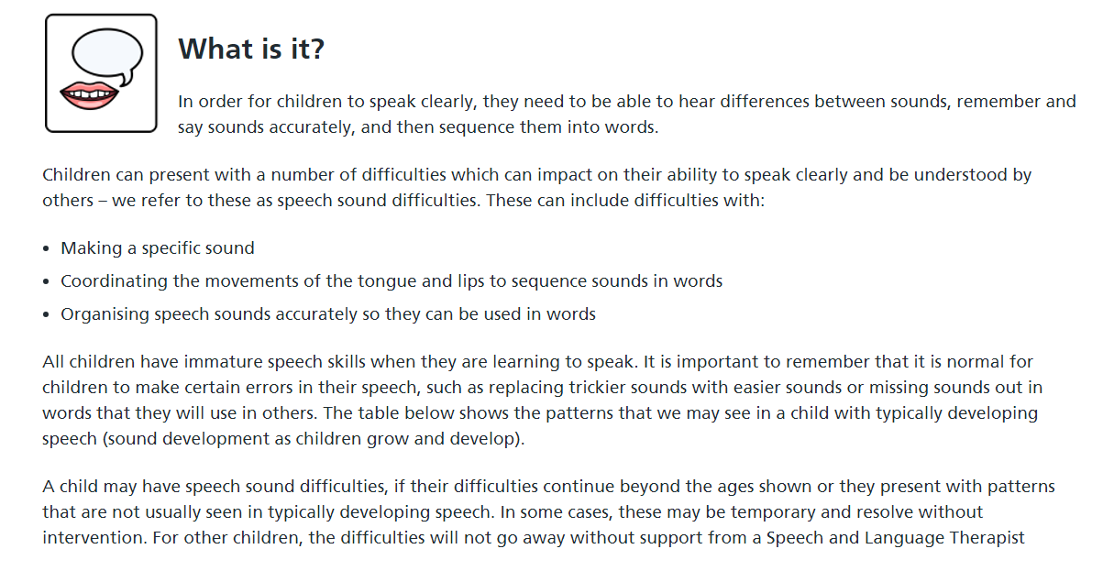
Speech sounds
Speech sounds

Slide 9
Speech sounds – expected errors
Changes | Examples | Expected age
Missing sounds off the end of words | ‘park’ – ‘par’ ‘tap’ – ‘ta’ | Up to 3 years
Using the same sounds in words | ‘soap’ – ‘poap’ ‘case’ – ‘cake’ | Up to 3 years
Changing quiet sounds in words – p,t,k to noisy sounds – b,d,g | ‘pot’ – ‘bot ‘tap’ -‘dap’ ‘cat’- ‘gat’ | Up to 3 years
Changing long sounds – f,s to short sounds – p/b, t/d | ‘feet’ – ‘peet’ or ‘beet’ ‘sun’ – ‘tun’ or ‘dun’ | Up to 3 years, 6 months
Changing back sounds – k to front sounds t/d | ‘car’ – ‘tar’ or ‘dar’ ‘bike’ – ‘bite’ | Up to 4 years
Changing ‘sh’, ‘ch’, ‘j’ | ‘fish’ – ‘fis’ ‘children’ – ‘tildren’ ‘orange’ – ‘oranz’ | Up to 5 years
Changing two sounds to just one sound | ‘tree’ – ‘tee’ or ‘dee’ ‘grass’ – ‘dass’ or ‘gass’ ‘spots’ – ‘bots’ | Up to 5 years
Changing ‘l’ and ‘r’ | ‘leaf’ – ‘jeaf’ ‘roof’ – ‘woof’ | Up to 6 years
Speech sounds

Slide 10
What to look for
Some children have speech difficulties which are not expected during development. These include:
Over 3 years old and parent / carer cannot understand most of the time.
Over 3 years old and less than 5 different consonant sounds produced on the Mini Speech Screen.
Over 3 years old and often does not repeat the words when asked (check words with a dash (-) on the Mini Speech Screen.
Over 4 years old and new people cannot understand most of the time.
Over 4 years old and does not repeat p, t, c/k, f, s accurately as single sounds.
Over 4 years and often did not say the words on their own (check words marked with * on the Mini Speech Screen).
Any age and always misses sounds off at the beginning of words e.g. ‘food’, -’odd’, ‘duck’ – ‘uck’.
Any age and always changes the sounds to c/k or g, e.g. ‘two’ – ‘coo’, ‘sea’ – ‘key’, ‘ball’ – ‘gall’.
Speech sounds

Slide 11
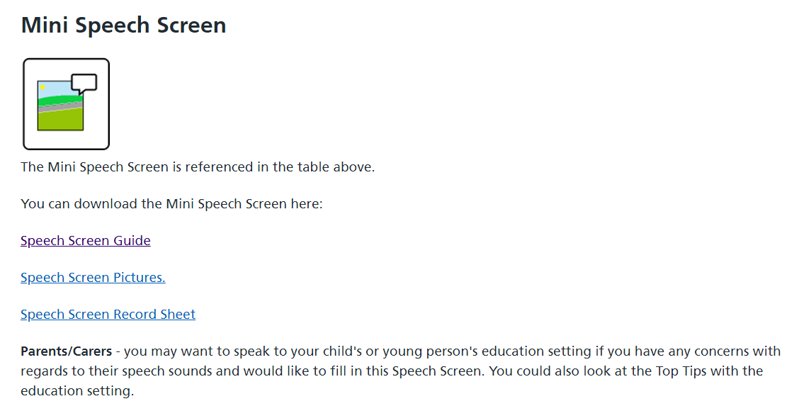
Mini Speech Screen
Speech sounds

Slide 12
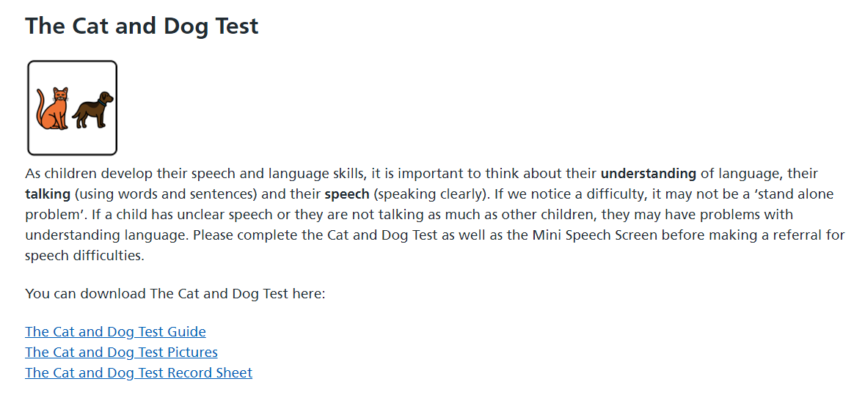
The Cat and the Dog Test
Speech sounds

Slide 13
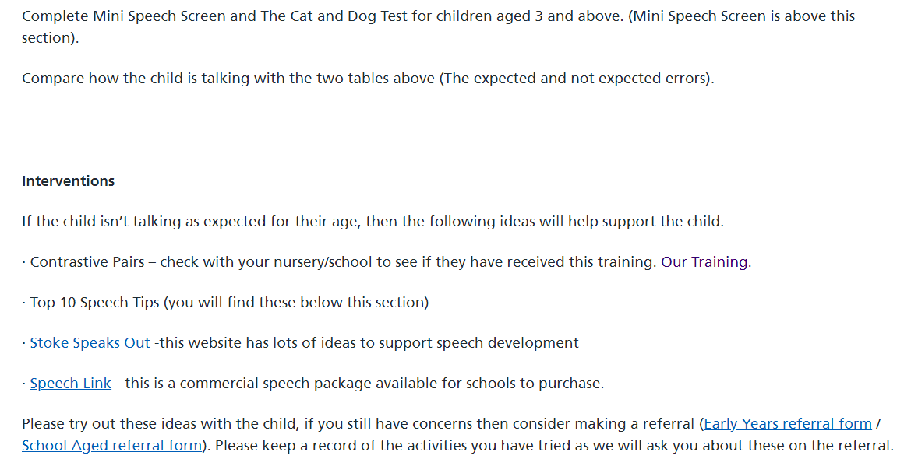
When to refer for speech difficulties
Speech sounds

Slide 14
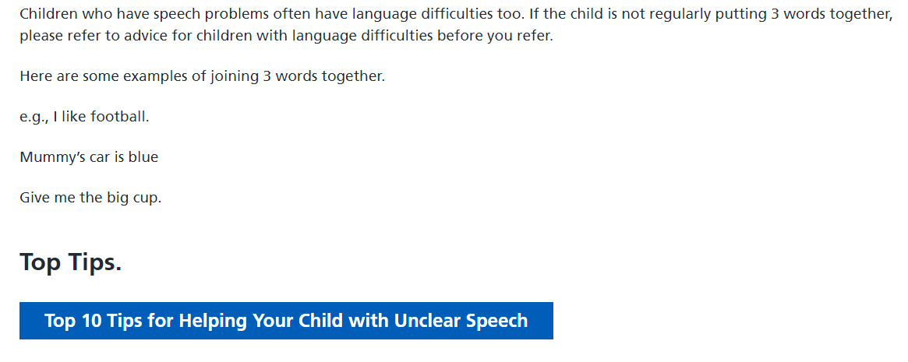
Also consider
Speech sounds

Slide 15
Related documents and training
Early Talk Boost
Early Talk Boost - Speech and Language UK: Changing young lives
Tiny Happy People
Tiny Happy People - Tips and advice for children's speech and language
Supporting and developing vocabulary and concepts in the early years
Supporting and Developing Vocabulary and Concepts in the Early Years training video – YouTube
The Communication Tree
14269.pdf
Supporting children with selective mutism
Supporting Children with Selective Mutism
Attention and listening
Attention & Listening 1 training video
Games for attention and listening
14006.pdf

Slide 16
Early Communication Screening Tool – What next?
Documents referenced:
Development Matters - Non-statutory curriculum guidance for the early years foundation stage
Letters_and_Sounds_-_DFES-00281-2007.pdf
(Phase 1 only)
Beverley.jones@shropshire.gov.uk
November 2024

